Slide 1
Previous Lecture
structure of the subsurface
grain size distribution of unconsolidated porous media
subterranean water
questions?
Notes:
1

Slide 2
Today
groundwater and aquifers
pressure and pressure head
storage properties
Notes:
2

Slide 3
Groundwater and Aquifers
Notes:
3

Slide 4
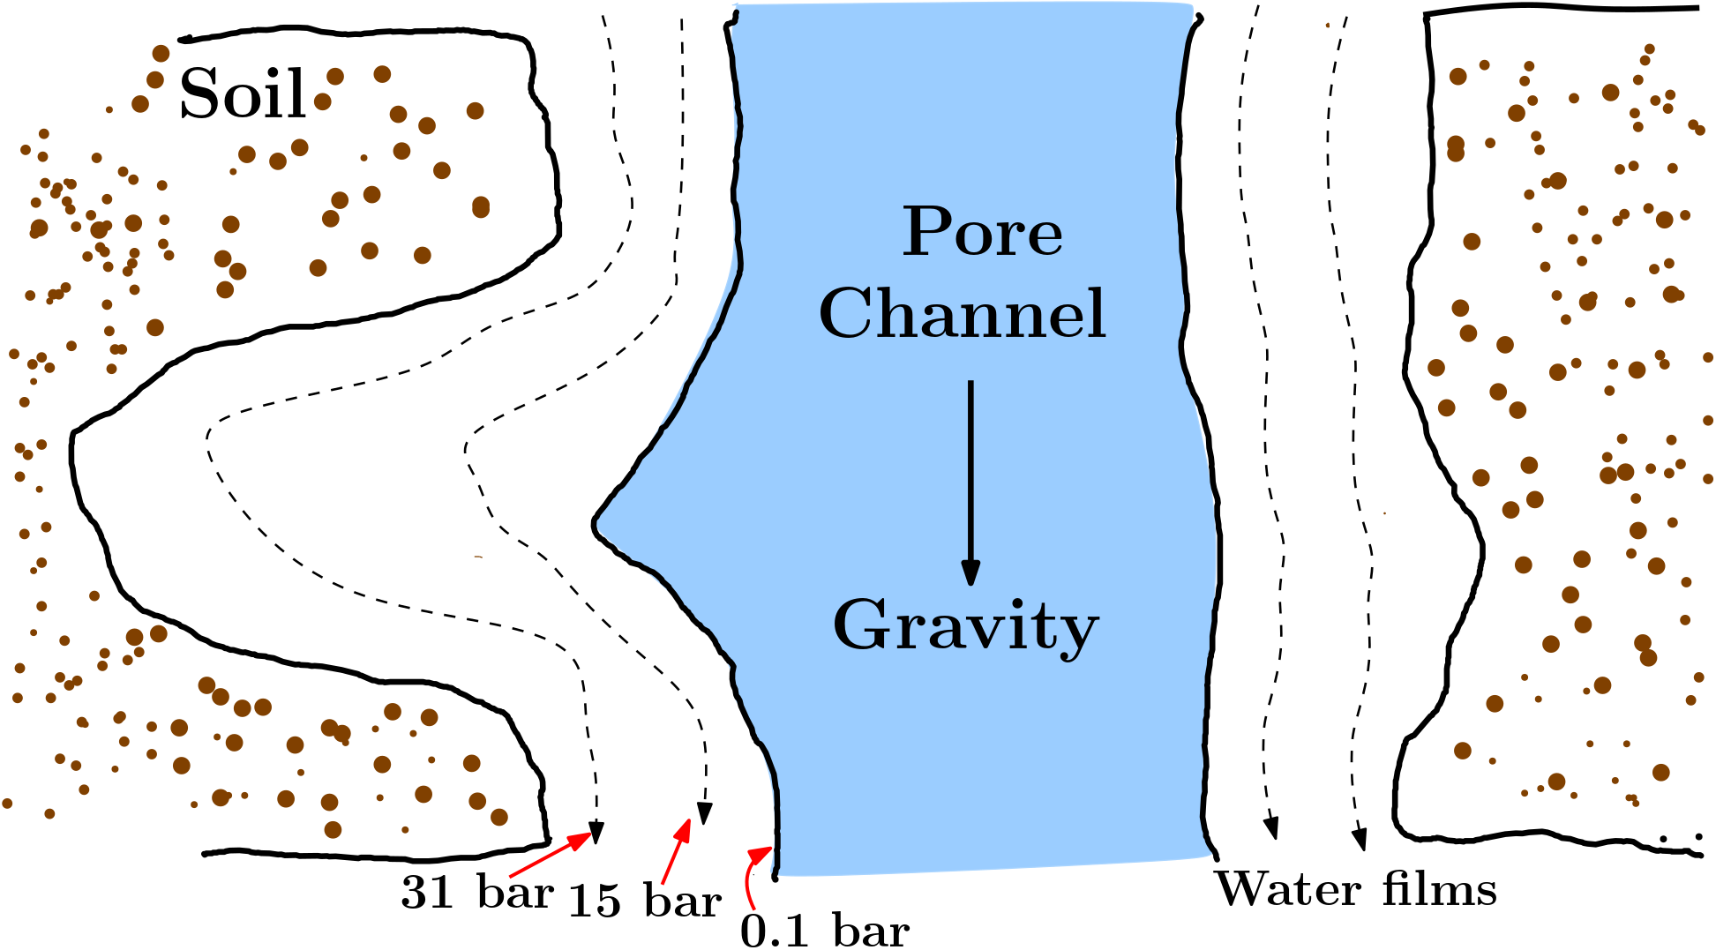
What is Groundwater?
Groundwater = subterranean water which
completely fills the pore space
and – in Germany! – is not subject to other forces than gravity.
German groundwater
International groundwater
Notes:
4

Slide 5
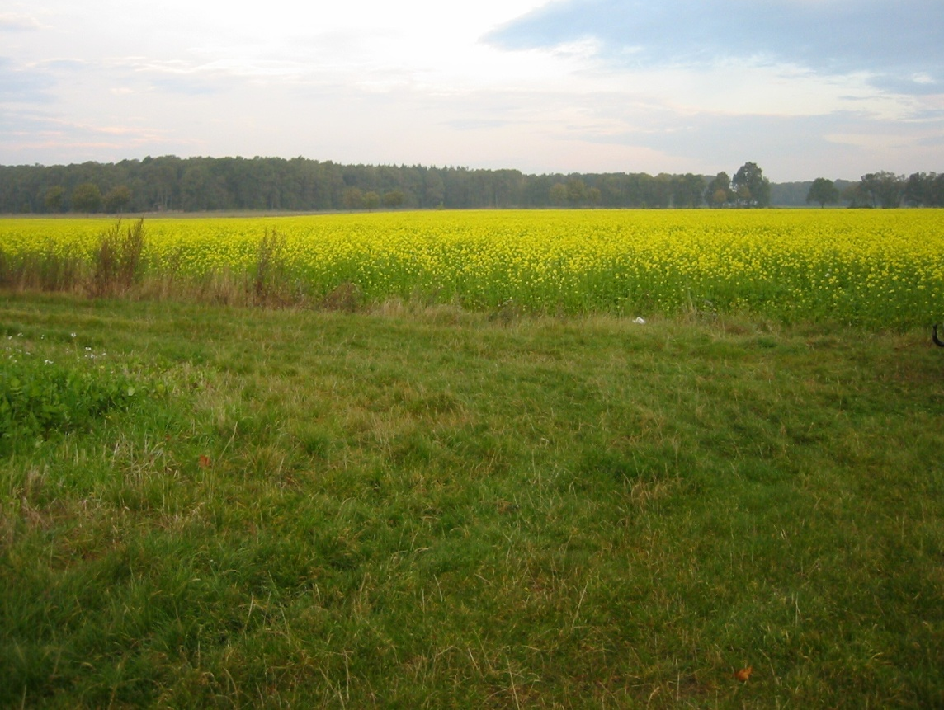

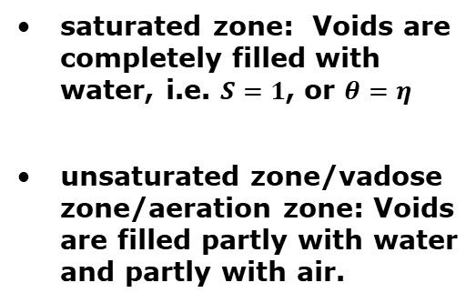
Schematic Overview
saturated zone: Voids are completely filled with water, i.e. $S=1$, or $θ=η$
unsaturated zone/vadose zone/aeration zone: Voids are filled partly with water and partly with air.
unsaturated zone or
vadose zone or
aeration zone
vadose water or
suspended water
groundwater table or
groundwater surface
saturated zone
groundwater
Notes:
5

Slide 6
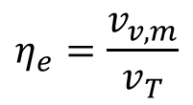
Effective Porosity
Adhesive water does not participate in water movement. The same is true for water in isolated pores or in dead-end pores.
immobile water = subterranean water not participating in water movement
mobile water = subterranean water participating in water movement
The volumetric share of voids which can be occupied by mobile water is termed effective porosity or flow-through porosity:
void volume [L³] available
for mobile water
$$η_{e}=\frac{v_{v,m}}{v_{T}}$$
effective porosity [-]
total volume [L³]
Notes:
6

Slide 7
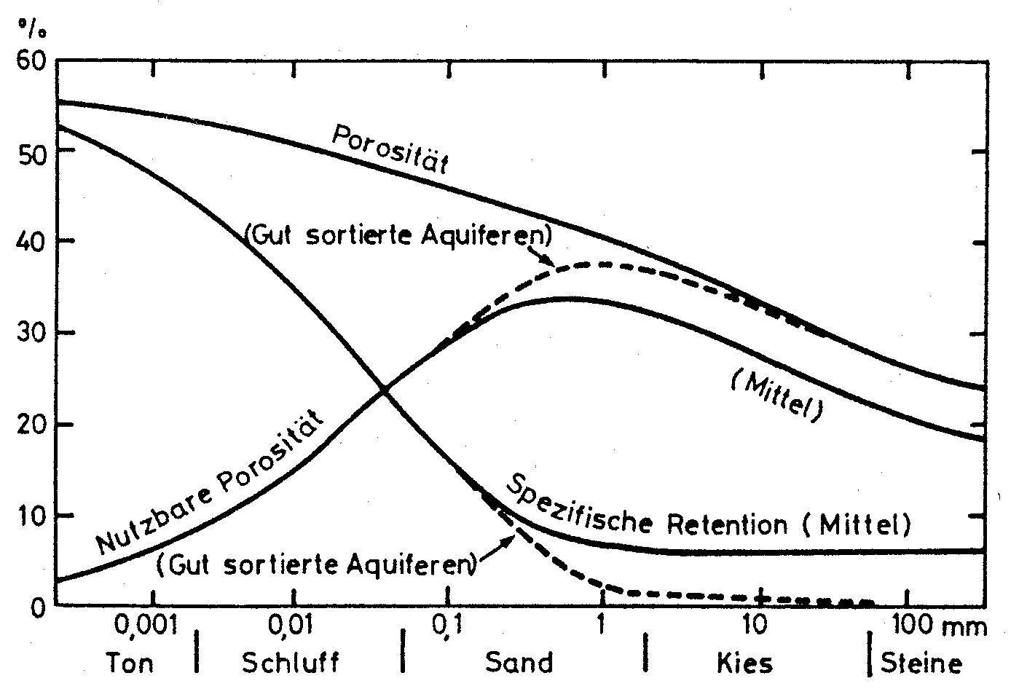
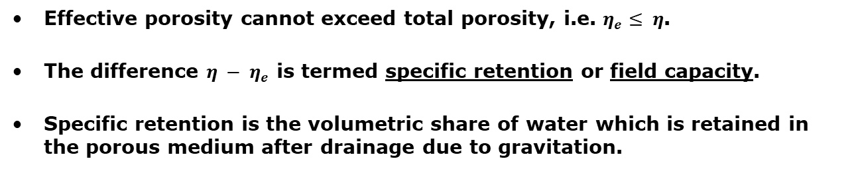
Effective vs. Total Porosity
Effective porosity cannot exceed total porosity, i.e. $η_{e}≤ η$.
The difference $η − η_{e}$ is termed specific retention or field capacity.
Specific retention is the volumetric share of water which is retained in the porous medium after drainage due to gravitation.
total porosity
(well sorted)
effective
porosity
(mean)
specific retention
(mean)
(well sorted)
clay
silt
sand
gravel
cobbles
Notes:
7

Slide 8
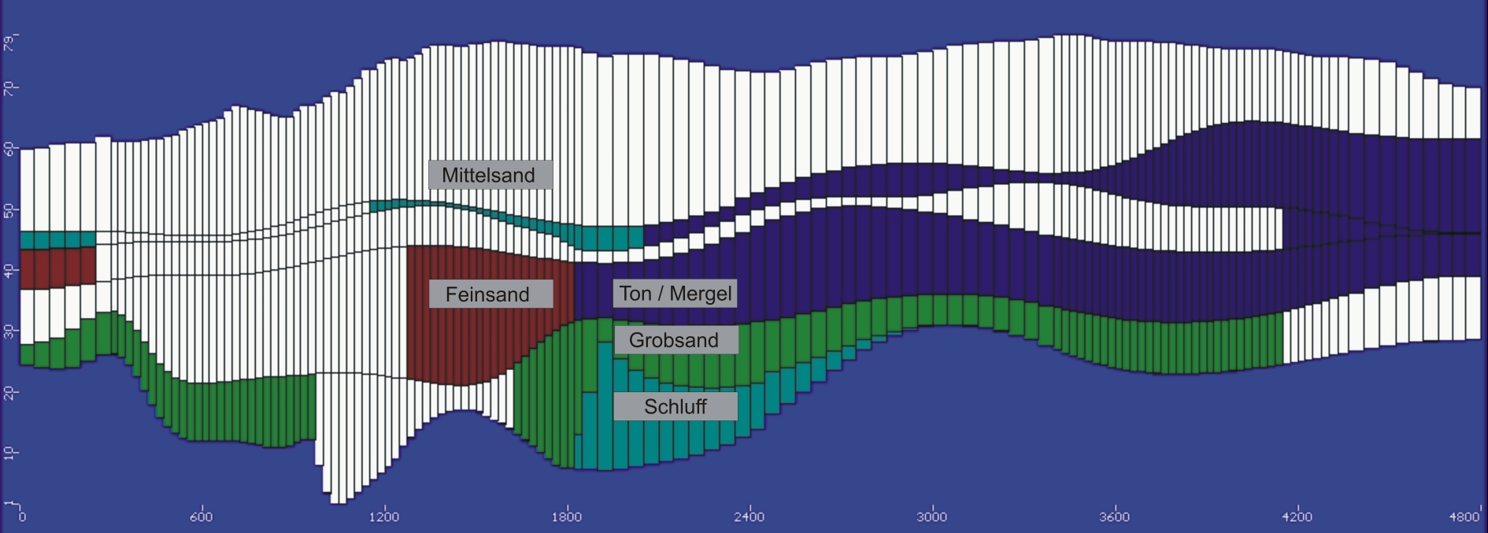
Aquifer, Aquitard, Aquiclude, Aquifuge
Subterranean formations can be classified by the capability to store and/ or transmit groundwater under natural conditions:
An aquifer or a groundwater reservoir can store and transmit significant (= exploitable) amounts of groundwater.
An aquitard can store and transmit groundwater but to a much lesser extent than an (adjacent) aquifer.
An aquiclude can store groundwater but cannot transmit groundwater.
An aquifuge can neither store nor transmit groundwater.
medium sand
fine sand
clay
coarse sand
silt
example from a computer model
Notes:
8

Slide 9
Top, Bottom, and Thickness
Aquifers usually appear as “layers“, i.e. their lateral extent is rather large as compared to their vertical extent (maybe 10 – 100 km vs. 10 – 100 m).
The upper aquifer boundary is called aquifer top; the lower boundary is called aquifer bottom.
The vertical distance between aquifer top and aquifer bottom is called aquifer thickness.
Upper and lower aquifer boundaries do not have to be horizontal and the thickness may be spatially variable.
Schematic example (vertical cross section):
aquifer
top
aquitard
aquifer
aquitard
aquifer
thickness
aquifer
bottom
Notes:
9

Slide 10
Unconfined Aquifer/Groundwater
aquifer top
groundwater table
aquifer bottom
Groundwater or an aquifer is termed unconfined (phreatic), if the groundwater does not extend up to the aquifer top.
The position of the groundwater table is therefore changed during water injection or extraction (“free“ groundwater table).
Water in a borehole rises up to the groundwater table.
Notes:
10

Slide 11
Confined Aquifers/Groundwater
pressure line
ground surface
aquifer top
aquifer bottom
Groundwater or an aquifer is termed confined, if the aquifer contains groundwater throughout its entire thickness.
The pore space remains completely water filled during water injection or (moderate) extraction.
This requires a low permeable cover layer. In addition, the groundwater recharge area must be located at higher altitude than the aquifer top.
The elevation of the groundwater table in the recharge area defines the position of the confined aquifer‘s pressure line.
Water in a borehole rises up to the pressure line (neglecting friction losses), i.e. higher than the elevation of the aquifer top.
Notes:
11

Slide 12
Artesian Groundwater
pressure line
ground surface
aquifer top
aquifer bottom
Artesian groundwater is confined groundwater with the pressure line above ground surface.
Water in a borehole rises up to the ground surface and then forms a fountain.
Artesian springs and Artesian wells are based on this principle.
Notes:
12

Slide 13
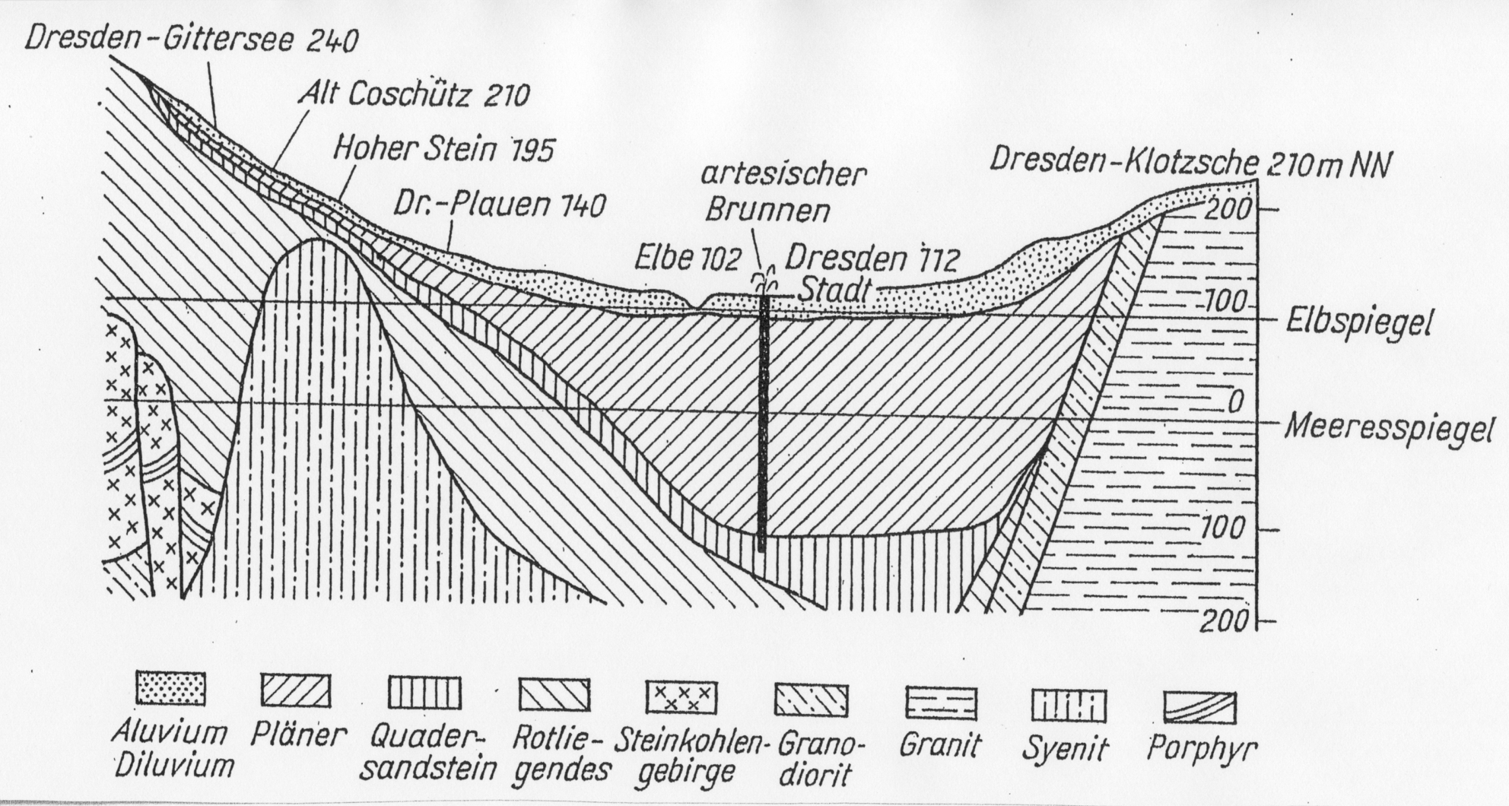
Subsurface Underneath Dresden
recharge area for lower aquifer
upper aquifer
(alluvial formation, unconsolidated)
lower
aquifer
(sandstone,
consolidated)
Notes:
13

Slide 14
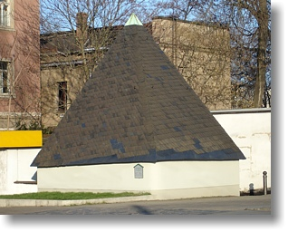
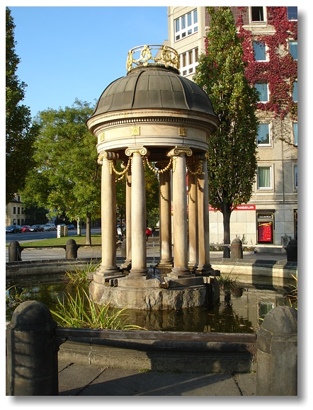
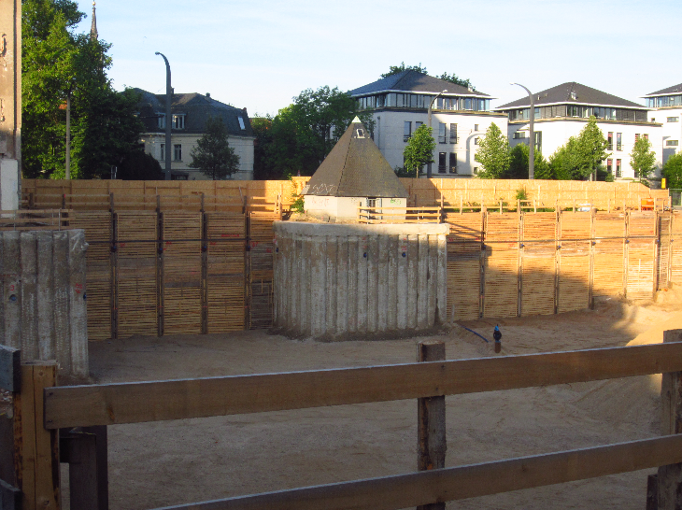
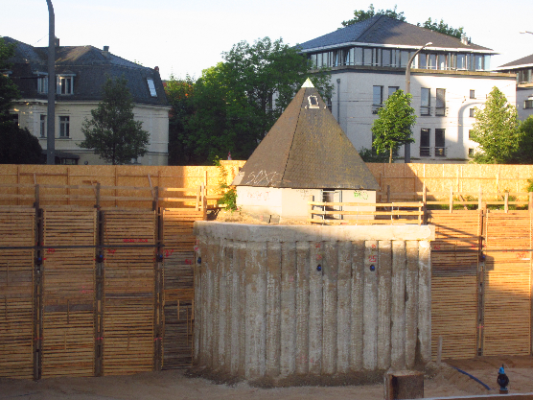
Artesian Well at Albertplatz
Artesian well at Albertplatz, Dresden
spring chamber before 2014
spring chamber during construction of an adjacent building (both photos by F. Tritschler, 2014)
Notes:
14

Slide 15
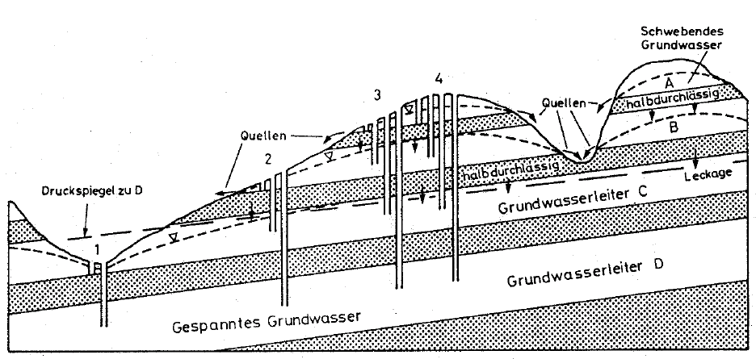
Example
Aquifer | Obs. point 1 | Obs. point 2 | Obs. point 3 | Obs. point 4
A | --- | ---
B | ---
C
D
unconfined
unconfined
unconfined
unconfined
confined
unconfined
unconfined
confined
confined
perched
aquifer
conf., artesian
confined
confined
confined
*perched aquifer = unconfined aquifer on top of another unconfined aquifer, separated from each other by a shallow aquitard
Notes:
15

Slide 16
Pressure and Pressure Head
Notes:
16

Slide 17
Hydrostatic Pressure I
(arbitrary) reference value
[M/L/T²]
z
p(L) = p_{L}
z = L
hydrostatic
pressure p(z)
[M/L/T²]
p(0) = p_{L}+ ρ·g·L
z = 0
fluid density
[M/L³]
acceleration of gravity
[L/T²]
We consider a vertical column containing a porous medium and water filling the voids completely. The bottom of the column is closed and the water therefore does not move.
There are two observation points for hydrostatic pressure p at elevation z = 0 and z = L, respectively.
Notes:
17

Slide 18
Hydrostatic Pressure II
z
p(L) = p_{L}
z = L
hydrostatic
pressure p(z)
[M/L/T²]
p(0) = p_{L}+ ρ·g·L
z = 0
Hydrostatic pressure p linearly increases with depth (or linearly decreases with increasing elevation)
In the above setup we have: p(z) = p_{L} + ρ·g·(L – z)
Pressure difference between the observation points: Δp = p(L) – p(0) = p_{L} – (p_{L} + ρ·g·L) = –ρ·g·L
There is a pressure difference but no water flow!
Notes:
18

Slide 19
Pressure Head
z
ψ(L) = ψ_{L}
z = L
pressure head
ψ(z) [L]
ψ(0) = ψ_{L}+ L
z = 0
Mostly, pressure head is used instead of pressure when dealing with hydraulic properties or phenomena of the subsurface.
(Hydrostatic) pressure head ψ is defined as ψ = p/(ρ·g).
Pressure head has dimension of length [L].
Hydrostatic pressure head linearly increases with depth (or linearly decreases with increasing elevation).
In the above setup we have: ψ(z) = ψ_{L} + L – z
Notes:
19
Psi, rho*g = unit weight

Slide 20
Pressure in a Confined Aquifer
p_{cb}
confining bed
p_{pm}
p_{w}
confined aquifer
The confining bed exerts a certain pressure p_{cb} on the aquifer.
This pressure is compensated partly by the porous medium and partly by the groundwater (pressures p_{pm} and p_{w}, respectively).
Therefore: p_{cb} + p_{pm} + p_{w} = 0
Storage properties of the aquifer and associated parameters can be understood by considering pressure changes.
Notes:
20

Slide 21
Change in Hydrostatic Pressure
p_{cb}
confining bed
p_{w}
p_{cb} + p_{pm} + p_{w} = 0
p_{pm}
confined aquifer
Lets consider a change in hydrostatic pressure Δp_{w} due to injection or release of groundwater and then compare “before“ and “after“.
From the above equation: Δp_{cb} + Δp_{pm} + Δp_{w} = 0
Hydrostatic pressure changes do not affect the weight of the confining bed and the exerted downward pressure remains unchanged.
Therefore we have Δp_{cb} = 0 and Δp_{pm} = –Δp_{w}.
This implies that an increase/a decrease of hydrostatic pressure automatically results in a decrease/an increase in the pressure exerted by the porous medium.
Notes:
21

Slide 22
Hydrostatic Pressure and Water Volume
p_{cb}
confining bed
p_{w}
Δp_{pm} = –Δp_{w}
p_{pm}
confined aquifer
The change in hydraulic pressure will have two effects with regard to water volume.
First, the hydraulic pressure change Δp_{w} directly leads to expansion / compression of the water and the water volume is accordingly increased /decreased.
Secondly, the opposite change Δp_{pm} = –Δp_{w} leads to compression/ expansion of the porous medium as a whole (not the individual grains!). This, in turn, results in a reduced/an enlarged pore space such that the stored water volume is decreased / increased.
Both effects contribute to aquifer storage properties (see next section).
Notes:
22

Slide 23
Storage Properties
Notes:
23

Slide 24
Change in Water Volume Invoked by Δp_{w}
The change in water volume due to a change in hydrostatic pressure is abbreviated by ΔV_{w}‘.
Relative changes in water volume, ΔV_{w}‘/V_{w}, are proportional to Δp_{w}:
hydrostatic
pressure change [M/L/T²]
relative change
in water volume [-]
compressibility
of water [LT²/M]
An increase/decrease in hydrostatic pressure results in an inflow/ outflow of water (compression/expansion of the water already present!).
The compressibility of water is roughly 4.4·10⁻¹⁰ m²/N.
The above equation can be rearranged to yield
total porosity [-]
change in
pressure head [L]
Notes:
24

Slide 25
Change in Total Volume Invoked by Δp_{pm}
A change Δp_{pm} in the pressure exerted by the porous medium on the confining layer results in a decrease/an increase ΔV_{T} in total aquifer volume (see previous section).
Both quantities are proportional to each other via
relative change
in total volume [-]
pressure change [M/L/T²]
compressibility
of the porous
medium [LT²/M]
The compressibility of the porous medium is roughly 10⁻¹⁰ – 10⁻⁸ m²/N for gravel, 10⁻⁹ – 10⁻⁷ m²/N for sand, and 10⁻⁸ – 10⁻⁶ m²/N for clay.
The above equation can be rearranged to yield
ΔV_{T} represents a change in volume of the porous medium as a whole. It is composed of a change in volume ΔV_{s} of the solids (which is negligible!) and another change ΔV_{w}‘‘ in water volume, i.e.
Notes:
25

Slide 26
Change in Water Volume Invoked by Δp_{pm}
From
and
we can immediately derive
As mentioned above, ΔV_{w}‘‘ denotes the change in water volume due to an increase/a decrease of pressure p_{pm} in the porous medium.
A decrease of pressure in the porous medium leads to an expansion of the porous medium and an associated increase in water volume (enlarged pore space).
An increase in pressure in the porous medium leads to a compression of the porous medium and an associated decrease in water volume (reduced pore space).
Notes:
26

Slide 27
Total Change in Water Volume
The total change ΔV_{w} in water volume consists of both effects caused by pressure changes Δp_{w} and Δp_{pm}
Therefore we have ΔV_{w} = ΔV_{w}‘ + ΔV_{w}‘‘
Using the results derived before, we can express how ΔV_{w} depends on changes Δψ in pressure head:
due to changes in
hydrostatic
pressure (Δp_{w})
due to pressure
changes in the
porous medium
(Δp_{pm})
Notes:
27

Slide 28
Specific Storage
Specific storage S_{s} is defined as the volume of water that is released from a unit aquifer volume if hydrostatic pressure head is reduced by one unit:
The dimension of specific storage is 1/L.
Both impacts on water volume discussed before have to be considered in order to quantify ΔV_{w} in the above equation:
Specific storage can therefore also be expressed as
Typical values for specific storage range from 10⁻⁶ 1/m (e.g. gravel) to 10⁻² 1/m (e.g. clay).
Notes:
28

Slide 29
Storativity (Confined Aquifers)
Due to their relatively large lateral extent, aquifers are mostly considered as spatially two-dimensional (2D) systems
In this case, specific storage S_{s} is replaced by the storativity or storage coefficient S
For confined aquifers S is simply obtained by multiplying S_{s} by the aquifer thickness m:
Storativity can be interpreted as the volume of water released from an aquifer volume extending from the aquifer bottom up to the aquifer top over a unit area if the hydrostatic pressure is reduced by one unit.
Storativity is dimensionless.
Notes:
29

Slide 30
Reference Volumes (Confined Aquifer)
A = 1
aquifer top
V_{T} = 1
Thickness, m
aquifer bottom
The reference volume for defining specific storage S_{s} is a unit cube (e.g. V_{T} = 1 m³).
The reference volume for defining storati-vity S is a cuboid extending from the aqui-fer bottom to the aquifer top over a unit area (e.g. A = 1 m² and V_{T} = A·m).
Notes:
30

Slide 31
Storativity (Unconfined Aquifers)
Actually, unconfined aquifers are always treated as 2D systems
As a consequence, storativity is used to quantify water storage properties
The definition of storativity remains unchanged in principle but the considered aquifer volume now extends from the aquifer bottom up to the water table
For unconfined aquifers, storativity values correspond to effective porosities
This is explained by the free groundwater table: Pressure changes simply lead to filling or emptying of voids
This is fundamentally different from the storage properties of confined aquifers discussed before: In confined aquifers all voids remain filled with groundwater during pressure changes and storage properties depend on the compressibilities of water and the porous medium
Notes:
31

Slide 32

Quick check what we have understood?
Pls. scan the QR- code
or
click link the link:
https://partici.fi/67879370

